Slide 1
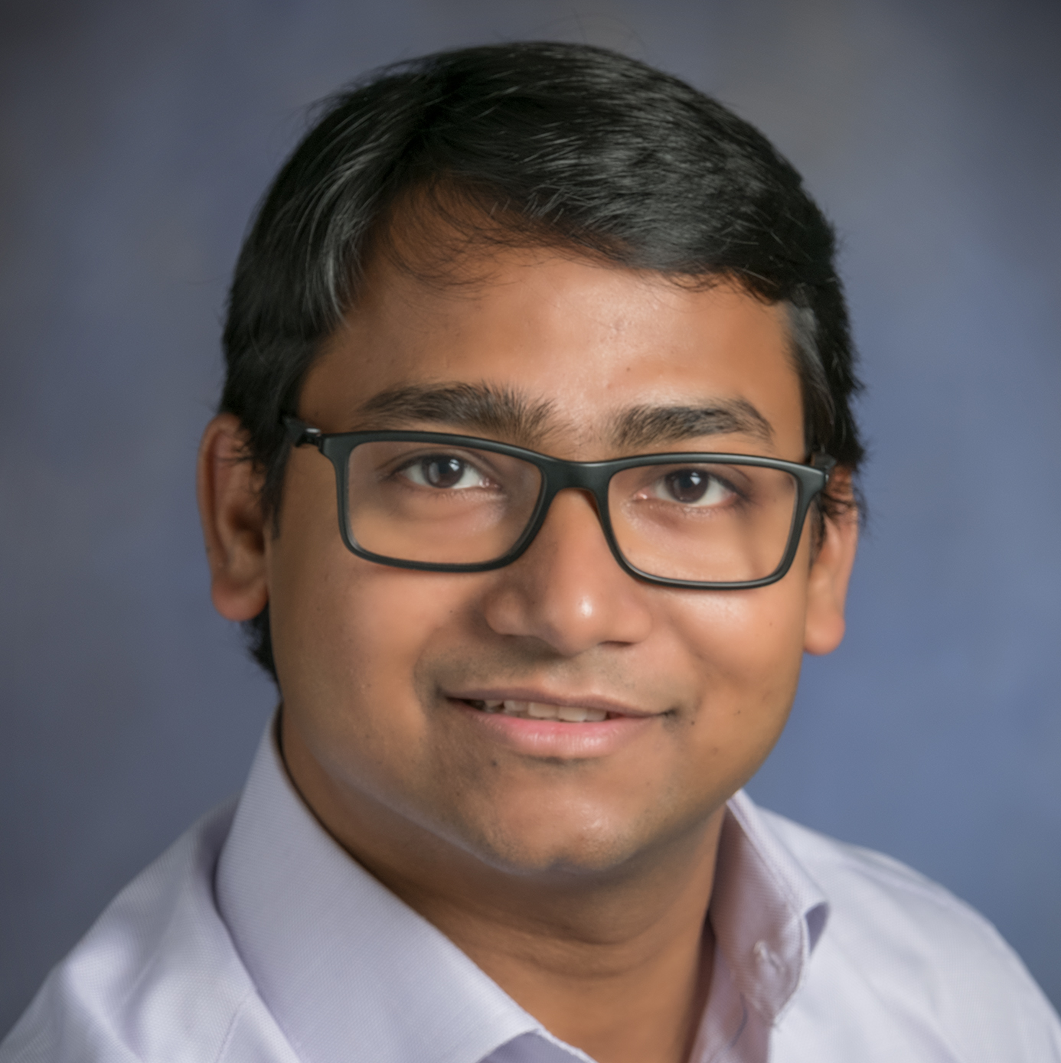
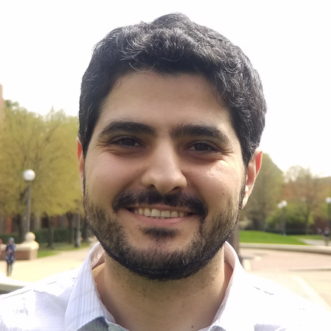
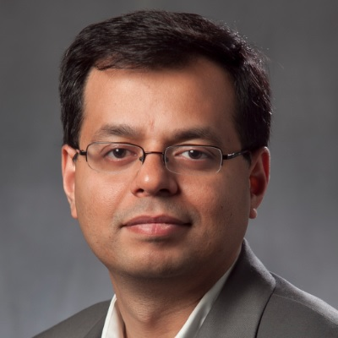
BackDoor: Making Microphones Hear Inaudible Sounds
Nirupam Roy
Haitham Hassanieh
Romit Roy Choudhury
University of Illinois at Urbana-Champaign
Notes:
1. Good morning, I am Nirupam Roy and today I want to talk to you about our work … on how sounds can be designed such that … microphones hear what they are NOT supposed to hear.
This is a joint work with Haitham and Romit, and we are all from the University of Illinois at Urbana Champaign.

Slide 2
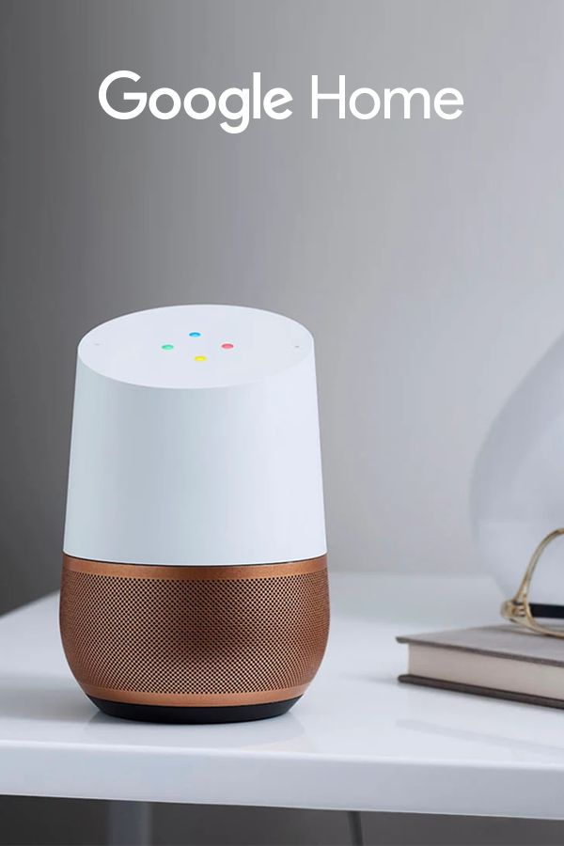
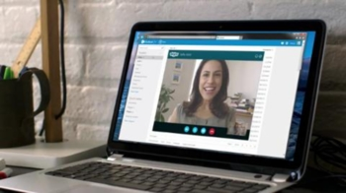
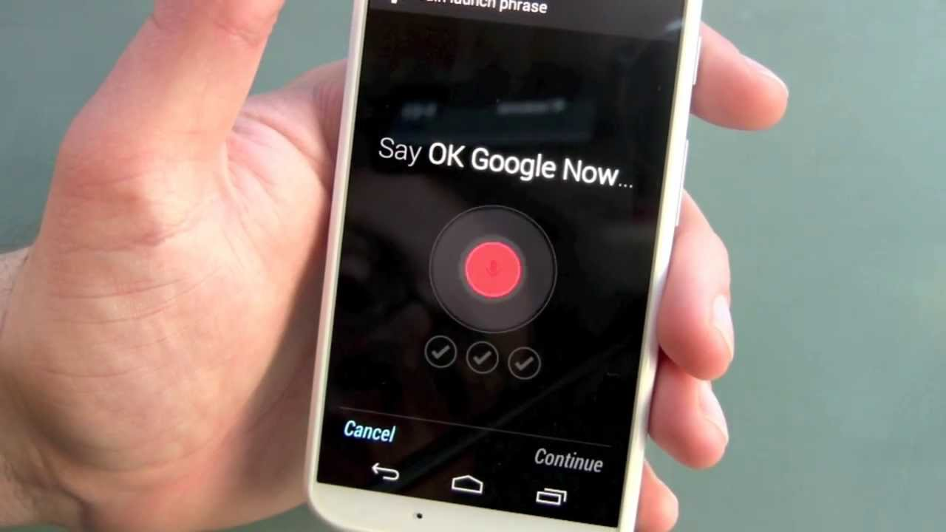
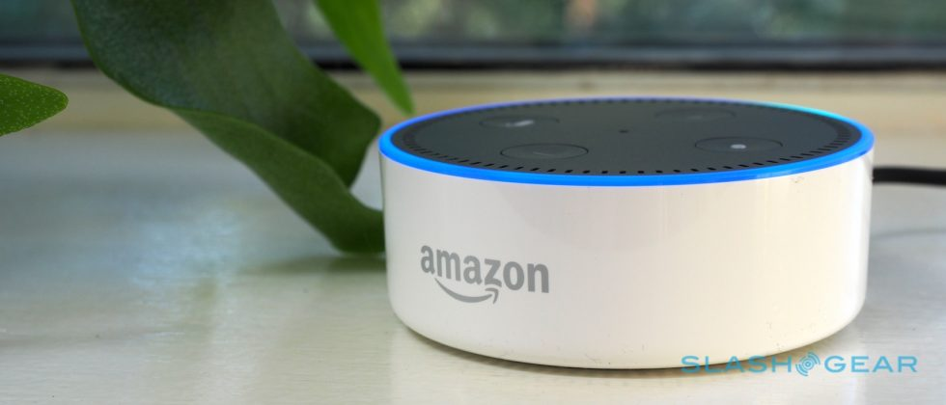
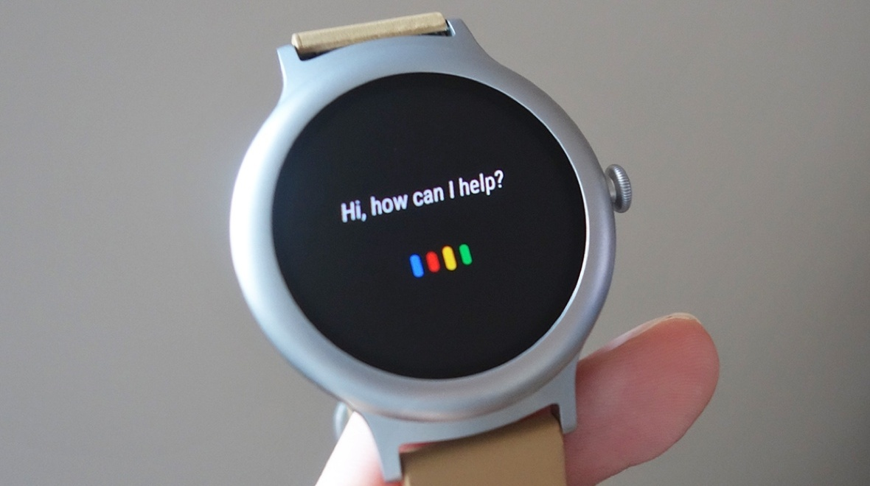
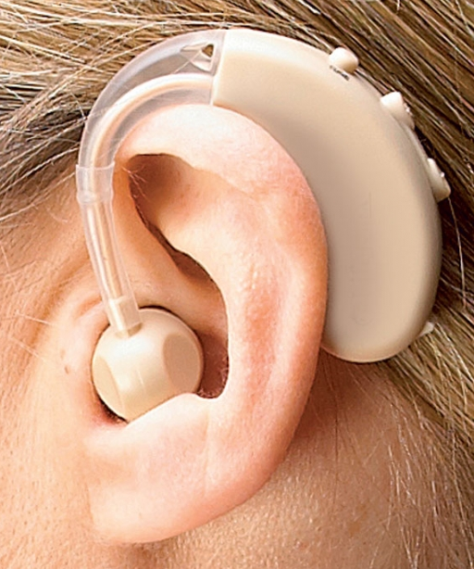
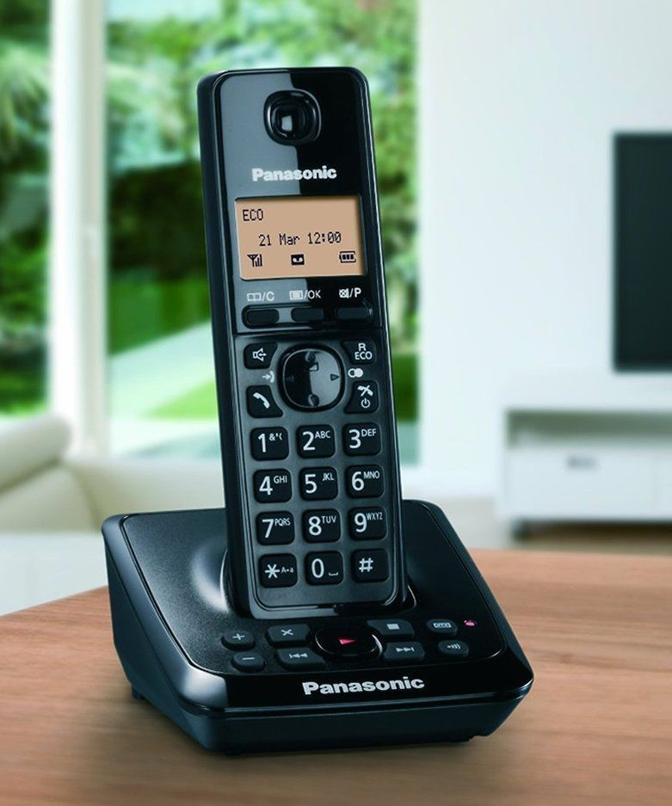
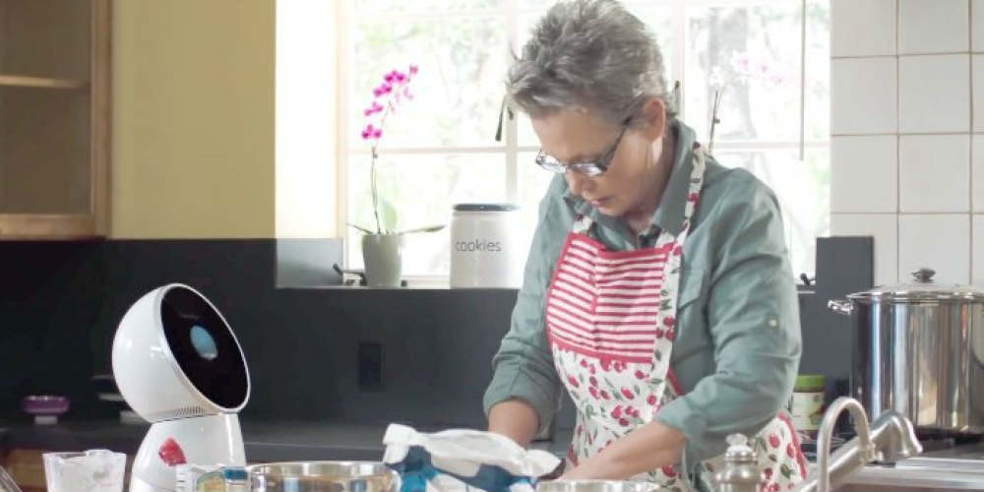
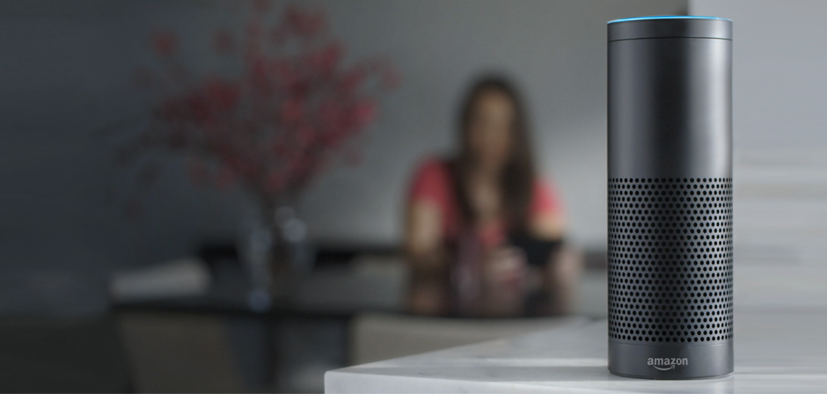
Microphones are everywhere
Notes:
2. We all know that hundreds of devices and applications are designed to record and process audible sounds …

Slide 3
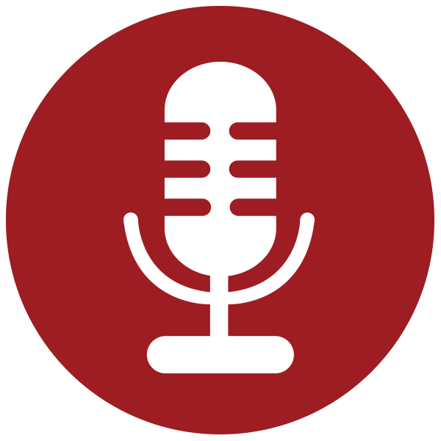
Microphones are everywhere
Notes:
3. and all these systems obviously rely on the microphone embedded in them.

Slide 4
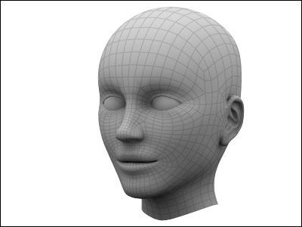

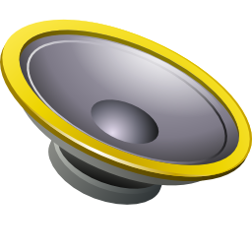
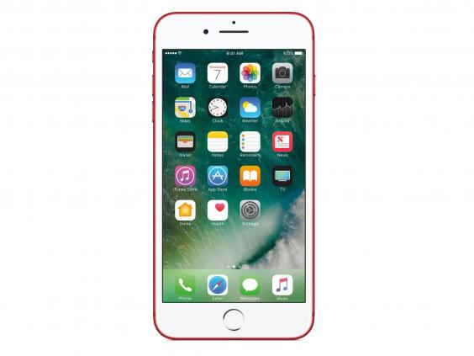
Microphones record audible sounds
I hear that
Audible sound
Speaker
I record that
Notes:
And as we know, microphones are just like human ears … if we play an audible sound … both microphones and humans can hear them ...

Slide 5
Inaudible, but recordable !
Speaker
Notes:
5. In this project … … we design sound…

Slide 6
Inaudible, but recordable !
I can’t hear that
Speaker
I record that
Notes:
that is inaudible to human ears … … but still recordable by microphones …
And to do that we don’t need to change anything in the microphone hardware ...

Slide 7
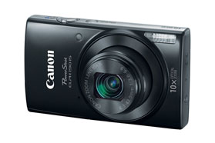
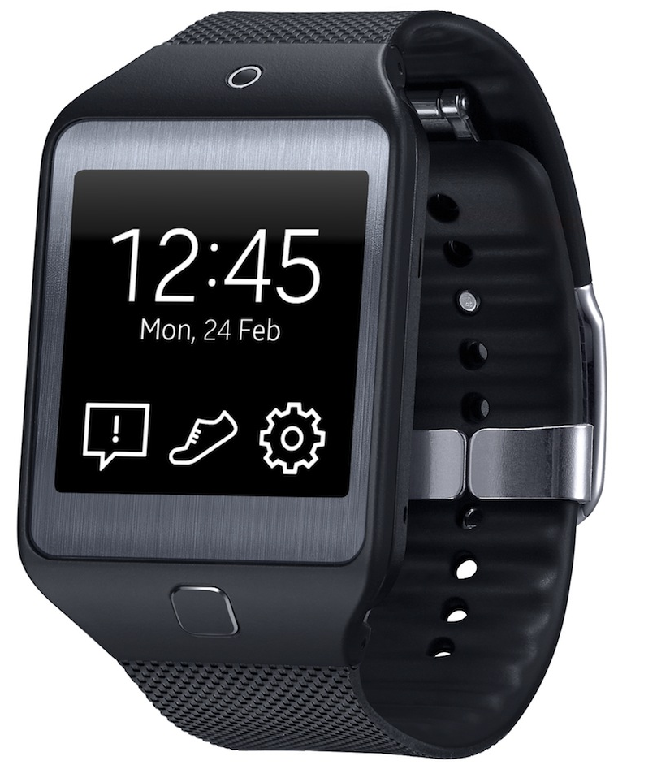

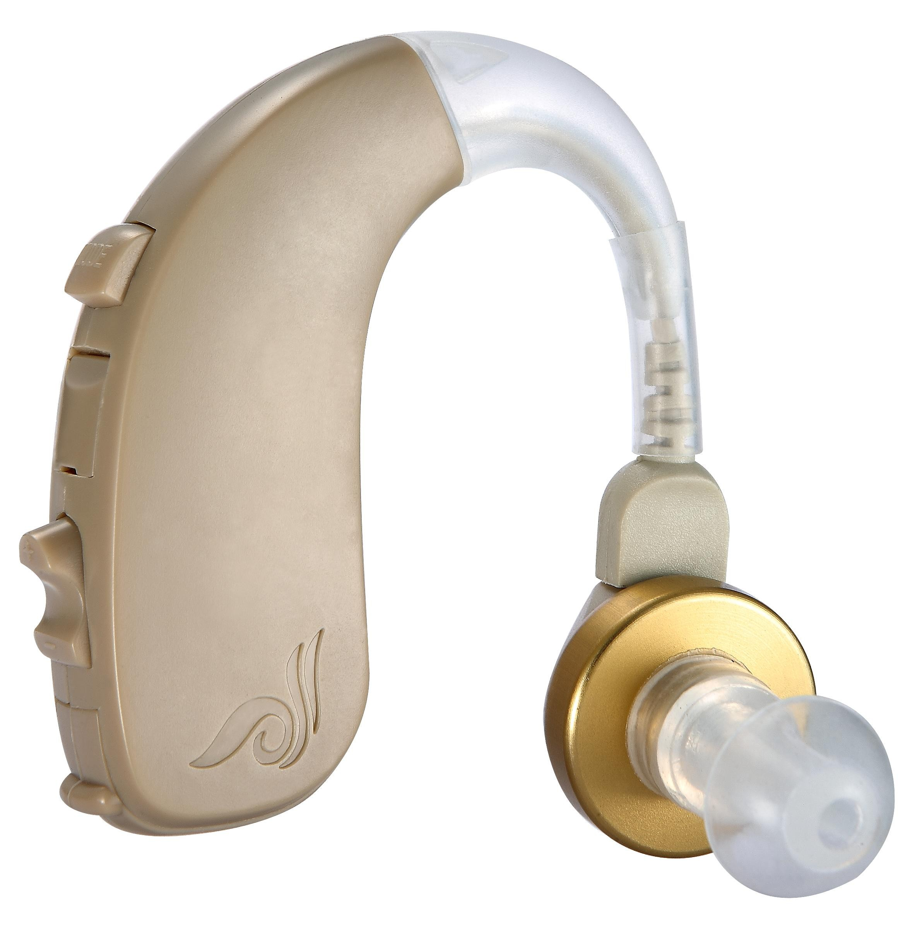
Works with unmodified devices
Camera
Smartwatch
Speaker
Laptop
Hearing Aid
Notes:
… which means our ideas are immediately applicable to all off-the-shelf devices that have microphones in them … … including smartphones, smartwatches, cameras, Amazon Echo, hearing aids, etc.

Slide 8
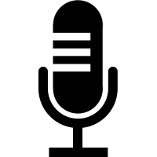


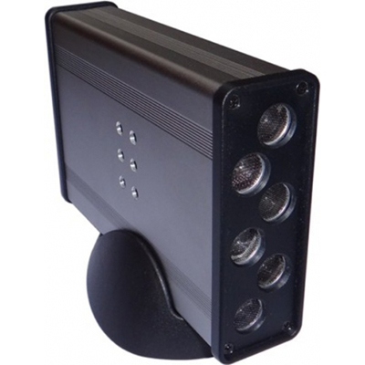
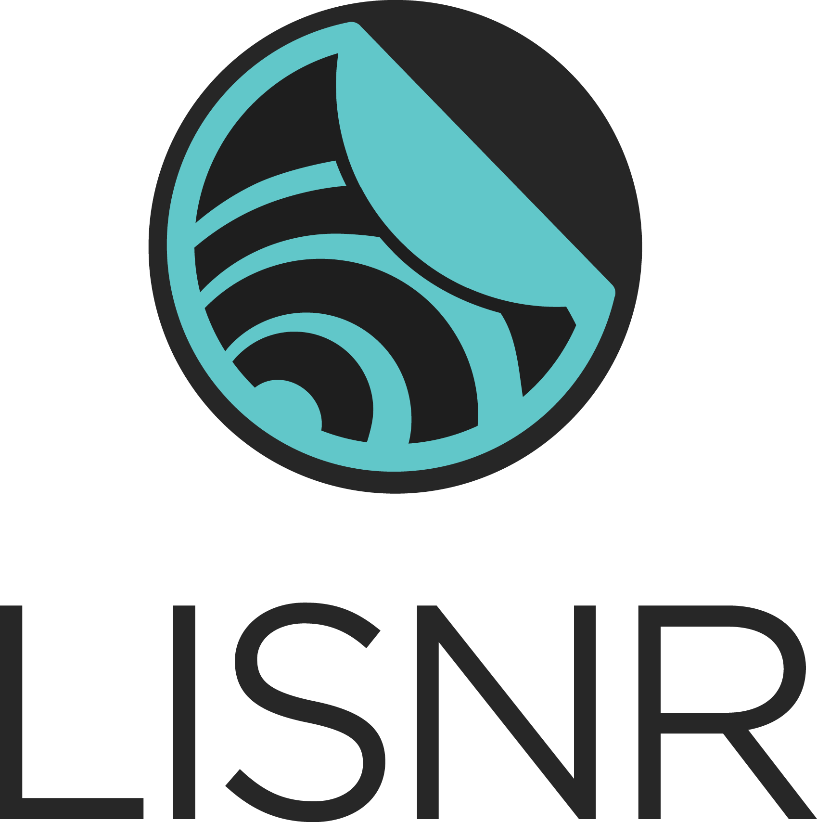
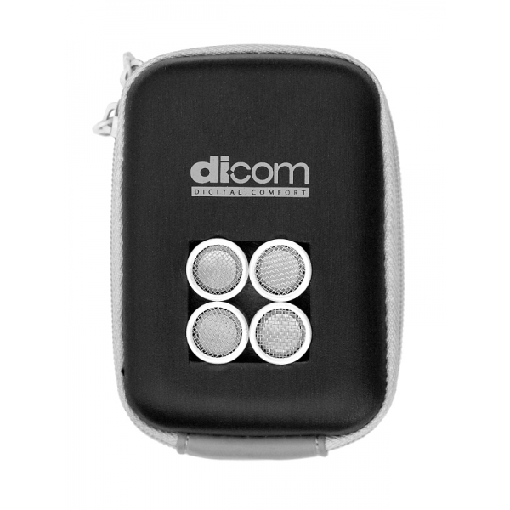
It’s not “near-ultrasound”
Near-ultrasound
Amplitude
10k
20k
30k
40k
50k
Frequency
Pseudo-ranging
SenSys’12
ApneaApp
MobiSys’15
chirp.io
DopLink
UbiComp’13
SoundWave
CHI’12
AAMouse
MobiSys’15
AirLink
UbiComp’14
lisnr.com
Spartacus
MobiSys’13
Crowd-counting
SenSys’12
Notes:
Now when I say this to people, they often think we are using NEAR ultrasound frequencies … which a small frequency band … just ABOVE human hearing range … but WITHIN the microphone’s processing range ...
Actually lot of past work have leveraged this difference to enable creative products and applications …
Our system has NOTHING to do with near ultrasound … …
nor is it about sending very soft sounds that humans cannot hear ...
Instead ... our idea is the following … …

Slide 9
Exploiting fundamental nonlinearity
Amplitude
10k
20k
30k
40k
50k
Frequency
Microphone
hardware
Notes:
We will use loud sounds at HIGH ultrasound frequencies … … WAY ABOVE the human AND microphone hearing range … but design them in a way such that … … when it passes through the microphone hardware, it automatically gets SHIFTED to the recordable range … … … …
In some sense … … the higher frequencies have found a BACKDOOR into the lower frequencies … and hence they become recordable … even if they should not have been …
I will explain the technical details in a few slides … … but before that let’s ask …

Slide 10
What can we do with it?
Notes:
What can we do with this BACKDOOR capability?

Slide 11
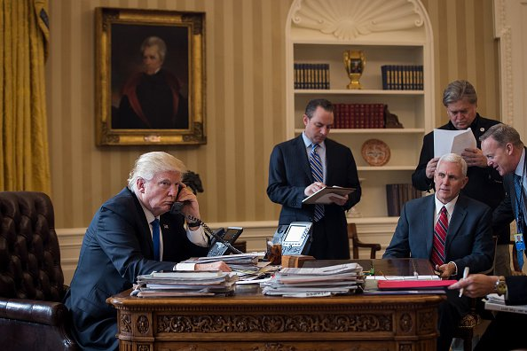
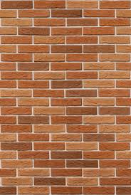
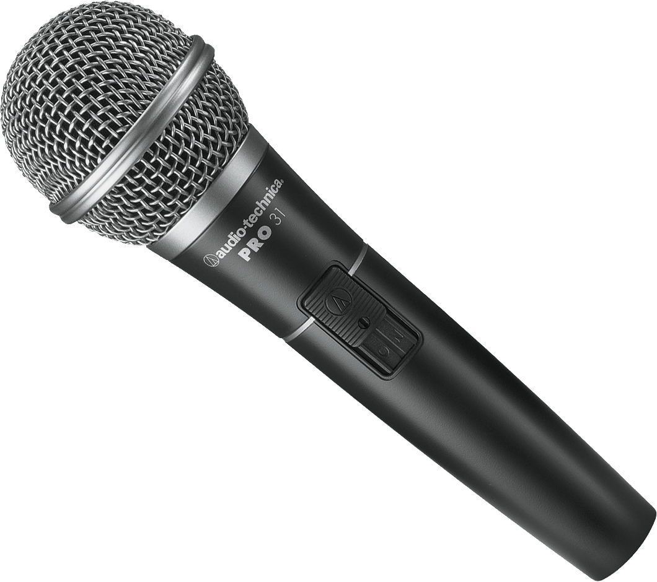
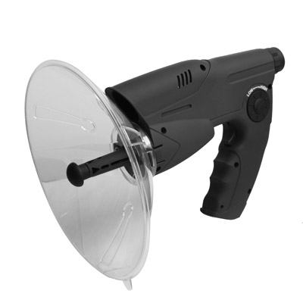
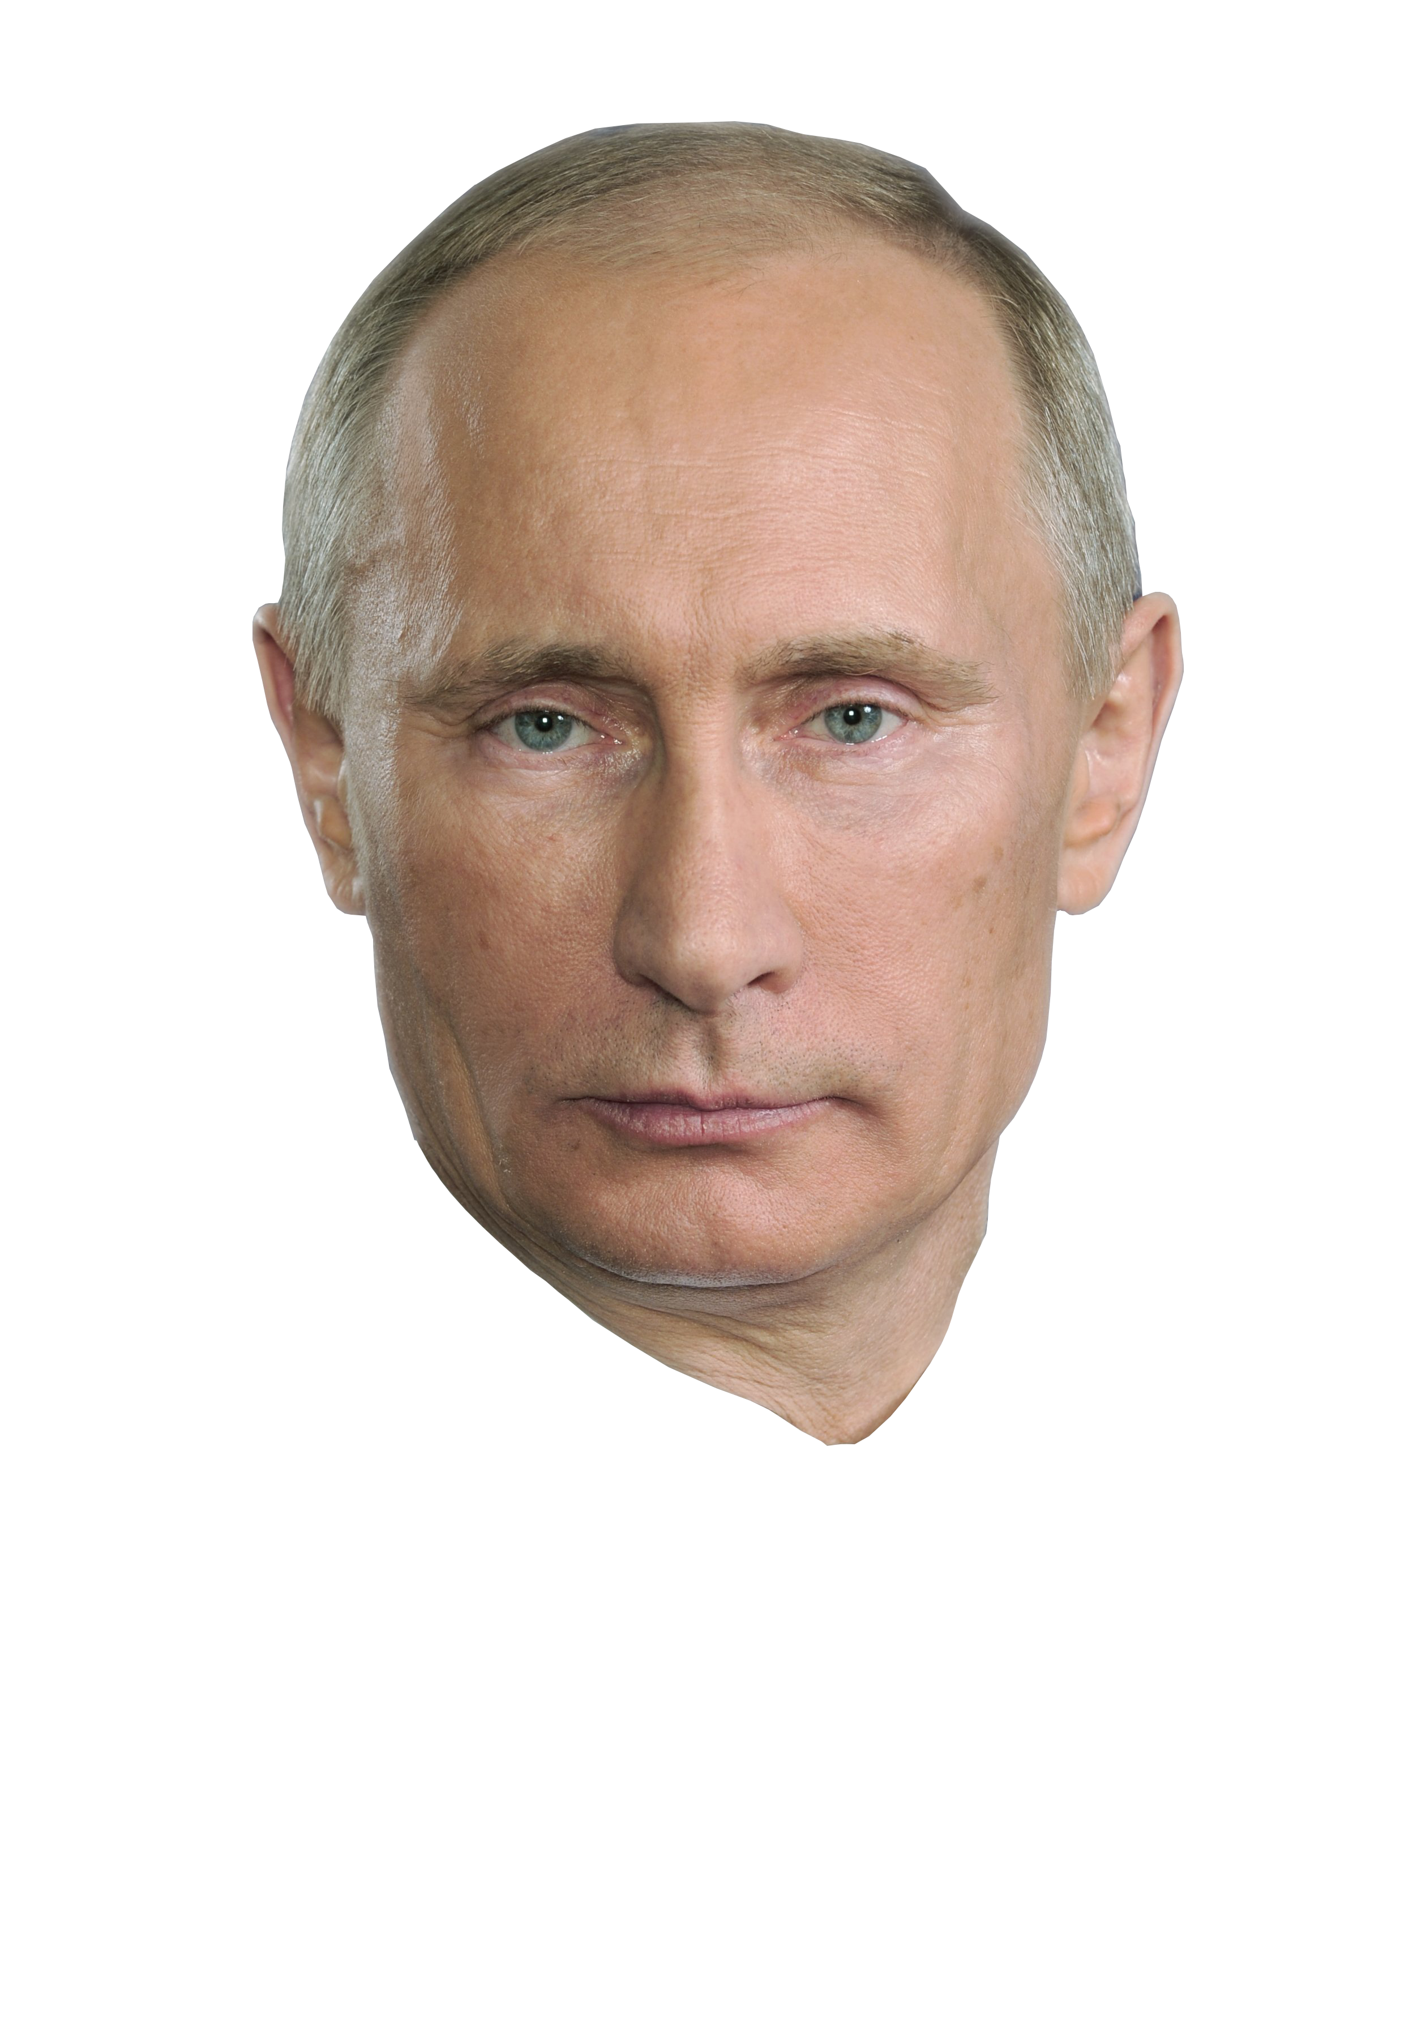
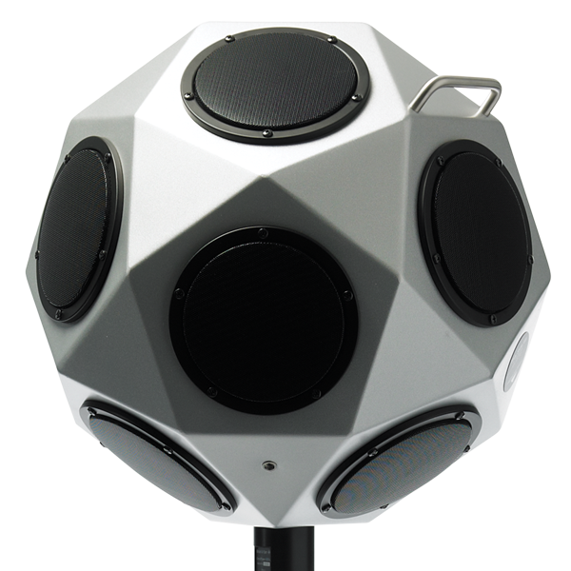

Application: Acoustic jammer
Notes:
Imagine an important meeting is going on and someone is sneakily recording it …
As of now, its not easy to prevent it ...
With BACKDOOR we can build a jammer that can send jamming sounds to block all the microphones ... but remains completely inaudible to humans … and hence, doesn’t interfere the meeting at all.

Slide 12

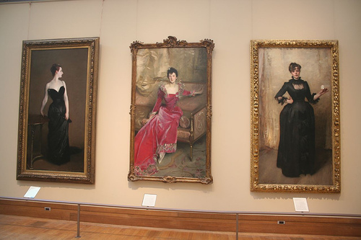
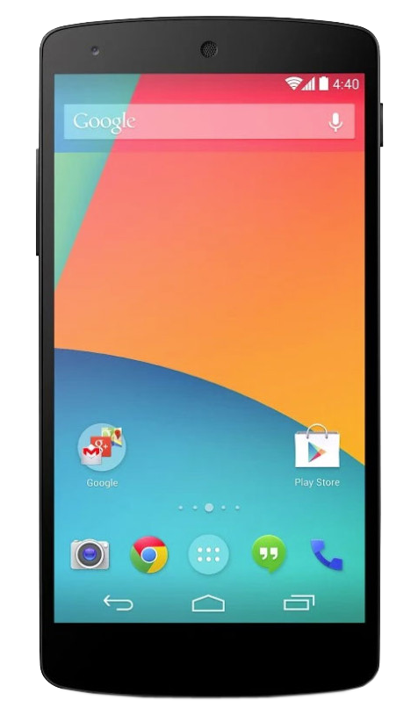

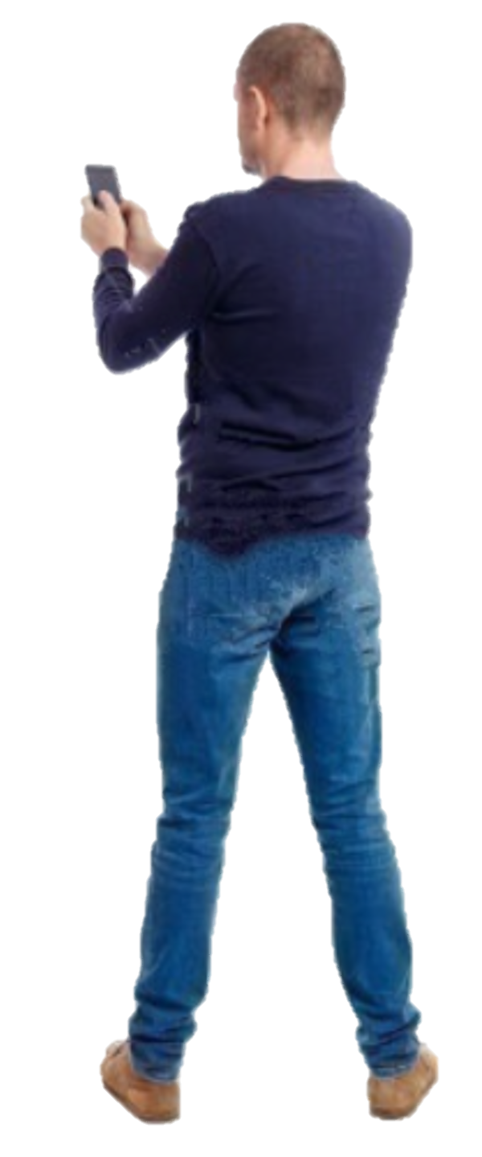
Application: Acoustic communication
$ 5.00
Notes:
A completely different use-case is in acoustic communication … … where data can be TRANSMITTED over high ultrasound frequencies but RECEIVED through regular microphones …
Thus … a shopping mall or museum can offer location based information from acoustic beacons … without making it audible to users.
Note that Near ultrasound can be used in this context…but it has a very limited bandwidth … around 2KHz … while backdoor can use the entire bandwidth of the microphone.

Slide 13
Threat: Acoustic DOS attack
Notes:
Of course, BACKDOOR may also be abused through evil applications … … including new Denial of Service attacks on acoustic devices..

Slide 14

Threat: Acoustic DOS attack
Jamming
hearing aids
Notes:
For example … an attacker can play extremely loud deafening sounds inside the hearing aid … without getting caught

Slide 15
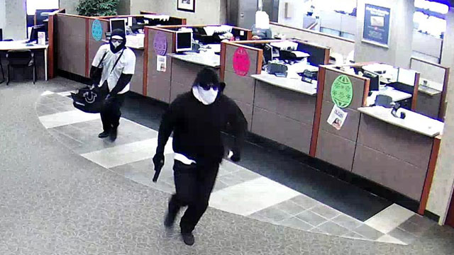
Threat: Acoustic DOS attack
Jamming
hearing aids
Blocking
911 calls
Notes:
Or can even jam all the 911 phone calls before a bank robbery.
While various applications are possible … this paper focuses on enabling the core capability … and understanding what is, or is not, possible …

Slide 16
Talk outline
1
Microphone Overview
2
System Design
3
Challenges
4
Evaluation
Notes:
In the rest of my talk ... I will first present a quick overview on microphones … followed by design … implementation … and evaluation

Slide 17
Talk outline
1
Microphone Overview
2
System Design
3
Challenges
4
Evaluation
Notes:
So lets get started ...

Slide 18
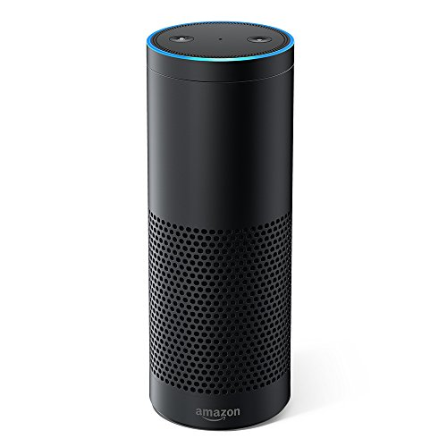


Microphone working principle
Diaphragm
Amplifier
Filter
ADC
Notes:
Microphones in today’s devices sense air vibrations and process them in 4 main stages.

Slide 19
Microphone working principle
Diaphragm
Amplifier
Filter
ADC
Notes:
The first stage is a diaphragm that converts the sound vibration into electrical voltage

Slide 20
Microphone working principle
Amplitude
10k
20k
30k
40k
50k
60k
70k
80k
90k
100k
Frequency
Diaphragm
Amplifier
Filter
ADC
Notes:
…This voltage, contain all the information of the sound … however, is too weak for further processing … and so …

Slide 21
Microphone working principle
Amplitude
10k
20k
30k
40k
50k
60k
70k
80k
90k
100k
Frequency
Diaphragm
Amplifier
Filter
ADC
Notes:
We need an amplifier …

Slide 22
Microphone working principle
Amplitude
10k
20k
30k
40k
50k
60k
70k
80k
90k
100k
Frequency
Diaphragm
Amplifier
Filter
ADC
Notes:
to amplify the signal power …
Now, this signal typically contains many more frequencies than the sampling system can handle …

Slide 23
Microphone working principle
Amplitude
10k
20k
30k
40k
50k
60k
70k
80k
90k
100k
Frequency
Diaphragm
Amplifier
Filter
ADC
Notes:
Hence, a low pass filter…

Slide 24
Microphone working principle
Microphone
filter
Amplitude
10k
20k
30k
40k
50k
60k
70k
80k
90k
100k
Frequency
Diaphragm
Amplifier
Filter
ADC
Notes:
removes the unwanted frequencies above 24 kHz …
And ultimately, this filtered signal is sampled by an ADC to generate digital sound samples

Slide 25
Microphone working principle
Microphone
filter
Amplitude
10k
20k
30k
40k
50k
60k
70k
80k
90k
100k
Frequency
Diaphragm
Amplifier
Filter
ADC
Notes:
Now … let’s focus a bit more on the amplifier

Slide 26
Microphone working principle
V_{out}
Output
Input
Output
V_{in}
Input
V_{out} = a₁V_{in}
V_{out} = a₁V_{in}+ a₂V_{in}²+
a₃V_{in}³+…
Frequency
10k
20k
30k
40k
50k
60k
70k
80k
90k
100k
Amplifier
Notes:
The INPUT OUTPUT relation of an amplifier can be modeled by a straight line … that is … … if the INPUT signal is Vin … after passing through the amplifier it will be multiplied by a constant gain A1 … to produce the amplified OUTPUT signal Vout.
This simple equation captures this behavior … … HOWEVER …this behavior is frequency dependent and this is linear equation is true ONLY when Vin is in the low audible frequency regime …
If the same amplifier is fed with a high frequency Vin … … the input output relation becomes non-linear … as shown by a curve.
Thus … Vout is a higher order polynomial of Vin … that is … a1 Vin + a2 Vin squared + a3 Vin cubed and so on … Now, since the third and higher order coefficients are weak

Slide 27
Microphone working principle
V_{out}
Output
Input
Output
V_{in}
Input
V_{out} = a₁V_{in}
V_{out} = a₁V_{in}+ a₂V_{in}²
Frequency
10k
20k
30k
40k
50k
60k
70k
80k
90k
100k
Amplifier
Notes:
… they can be ignored for practical purposes …
BUT … … the second order term is reasonably strong … and more IMPORTANTLY … it is fundamental to all amplifiers …
A far more expensive amplifier may be linear over a larger frequency range … but it will always exhibit non-linearity above some frequency threshold …

Slide 28
Microphone working principle
V_{out}
Output
Input
Output
V_{in}
Input
V_{out} = a₁V_{in}
V_{out} = a₁V_{in}+ a₂V_{in}²
Frequency
10k
20k
30k
40k
50k
60k
70k
80k
90k
100k
Amplifier
Notes:
BACKDOOR will exploit this hardware non-linearity …to force microphones into listening frequencies what it is not designed to …

Slide 29
Talk outline
1
Microphone Overview
2
System Design
3
Challenges
4
Evaluation
Notes:
Let me now explain our key design idea ...

Slide 30
Exploiting amplifier non-linearity
F₁= 50kHz
F₂= 40kHz
Microphone
filter
F₂
F₁
Amplitude
10k
20k
30k
40k
50k
60k
70k
80k
90k
100k
Frequency
Notes:
Consider the simple case where we are playing two high frequencies … F1 = 50kHz … and F2 = 40kHz … through a speaker …
These frequencies will appear in the received spectrum ...

Slide 31
Exploiting amplifier non-linearity
F₁= 50kHz
F₂= 40kHz
Microphone
filter
F₂
F₁
Amplitude
10k
20k
30k
40k
50k
60k
70k
80k
90k
100k
Frequency
V_{out} = a₁V_{in}+ a₂V_{in}²
( sin F₁ + sin F₂ )²
= cos 2F₁
+ cos 2F₂
+ cos (F₁+F₂)
+ cos (F₁- F₂)
Notes:
and then will pass through the amplifier … meaning that the signals will get SQUARED … due to the non-linearity
From simple trigonometry … sin F1 + sin F2 SQUARED will result in a signal with 4 frequency components … namely 2F1 … 2F2 … F1+F2 … and F1—F2.

Slide 32
Exploiting amplifier non-linearity
F₁= 50kHz
F₂= 40kHz
Microphone
filter
F₂
F₁
2F₂
(F₁+F₂)
2F₁
Amplitude
10k
20k
30k
40k
50k
60k
70k
80k
90k
100k
Frequency
V_{out} = a₁V_{in}+ a₂V_{in}²
( sin F₁ + sin F₂ )²
= cos 2F₁
+ cos 2F₂
+ cos (F₁+F₂)
+ cos (F₁- F₂)
Notes:
Observe that the first 3 components are at EVEN HIGHER frequencies … …

Slide 33
Exploiting amplifier non-linearity
F₁= 50kHz
F₂= 40kHz
Microphone
filter
F₂
F₁
2F₂
(F₁+F₂)
2F₁
Amplitude
10k
20k
30k
40k
50k
60k
70k
80k
90k
100k
Frequency
V_{out} = a₁V_{in}+ a₂V_{in}²
( sin F₁ + sin F₂ )²
= cos 2F₁
+ cos 2F₂
+ cos (F₁+F₂)
+ cos (F₁- F₂)
Notes:
and will all be removed by the low pass filter.

Slide 34
Exploiting amplifier non-linearity
F₁= 50kHz
F₂= 40kHz
(F₁-F₂)
Microphone
filter
F₂
F₁
2F₂
(F₁+F₂)
2F₁
Amplitude
10k
20k
30k
40k
50k
60k
70k
80k
90k
100k
Frequency
V_{out} = a₁V_{in}+ a₂V_{in}²
( sin F₁ + sin F₂ )²
= cos 2F₁
+ cos 2F₂
+ cos (F₁+F₂)
+ cos (F₁- F₂)
Notes:
However, the fourth component is much lower … since it is the DIFFERENCE of the 2 frequencies …
If F1 and F2 are chosen correctly … this 4th component can survive the filter … and actually get recorded by the microphone.

Slide 35
Exploiting amplifier non-linearity
F₁= 50kHz
F₂= 40kHz
(F₁-F₂)
Microphone
filter
F₂
F₁
Amplitude
10k
20k
30k
40k
50k
60k
70k
80k
90k
100k
Frequency
Notes:
As a generalization … a whole set of frequencies can be TRANSLATED into the lower frequency band by using an appropriate frequency F2 … at a slightly lower value.

Slide 36
Exploiting amplifier non-linearity
F₁= 50kHz
F₂= 40kHz
(F₁-F₂)
Microphone
filter
F₂
F₁
Amplitude
10k
20k
30k
40k
50k
60k
70k
80k
90k
100k
Frequency
Notes:
In other words … we can modulate F1 with data bits … or even with jamming signals … depending on the application …
And clearly, the microphone would record it.

Slide 37
Talk outline
1
Microphone Overview
2
System Design
3
Challenges
4
Evaluation
Notes:
Of course … this core idea is clean in theory … but faces many hurdles in practice …
In the interest of time … let me quickly skim over some major challenges.

Slide 38
Challenges
F₂
F₁
Amplitude
10k
20k
30k
40k
50k
60k
70k
80k
90k
100k
Frequency
Speaker’s
nonlinearity
Microphone’s
nonlinearity
F₁-F₂
F₂
F₁
2F₂
F₁+F₂
2F₁
Amplitude
10k
20k
30k
40k
50k
60k
70k
80k
90k
100k
Frequency
Notes:
So far we learned the following… if we play multiple high frequency tones…the microphone non-linearity will create multiple frequencies… including recordable components.
Now what if the speaker itself is nonlinear… in fact the ultrasonic speakers have some level of non-linearity…which means

Slide 39
Challenges
F₁-F₂
F₂
F₁
2F₂
F₁+F₂
2F₁
Amplitude
10k
20k
30k
40k
50k
60k
70k
80k
90k
100k
Frequency
Speaker’s
nonlinearity
Microphone’s
nonlinearity
F₁-F₂
F₂
F₁
2F₂
F₁+F₂
2F₁
Amplitude
10k
20k
30k
40k
50k
60k
70k
80k
90k
100k
Frequency
Notes:
The signal get shifted to the audible range inside the speaker and makes audible noise…

Slide 40
Challenges
F₁-F₂
F₂
F₁
2F₂
F₁+F₂
2F₁
Amplitude
10k
20k
30k
40k
50k
60k
70k
80k
90k
100k
Frequency
Microphone’s
nonlinearity
F₁-F₂
F₂
F₁
2F₂
F₁+F₂
2F₁
Amplitude
10k
20k
30k
40k
50k
60k
70k
80k
90k
100k
Frequency
Notes:
Actually it is not the most difficult problem …we can use multiple speaker to send these tones separately and prevent them from mixing at the source…

Slide 41
Challenges
Amplitude modulation
Ultrasonic speaker
Notes:
but it is challenging when we try to modulate the input signal…for example if we use amplitude modulation to encode our databits…because of the nonlinearity of speaker the signal gets SELF_DEMODULATED and starts generating audible sound…
So we can not use any modulation that changes the envelop of the signal…

Slide 42
Challenges
Frequencymodulation
Ultrasonic speaker
Notes:
So, we can adapt a variation of frequency modulation...which does not change the amplitude of the signal…
Even frequency modulation does not work right away, because the ringing effect piezoelectric speaker kicks in … COLVOLVES with this signal create audible sounds…we need to properly precode the input to prevent this…

Slide 43
Challenges
Signal self-demodulation
Piezoelectric ringing effect
Carrier intermixing
Spectrum inversion
Carrier power allocation
Notes:
Not only that…there are other challenges … like the carrier signals gets intermixed with each other...the spectrum of the transmitted signal gets inversed and overlapped…also we need to properly allocate the power to different frequencies to keep the third and higher order terms under control…
We have to take care of all these challenges to be able to make sound which is inaudible, yet recordable by microphone. Please refer to our paper for a systematic discussion of these challenges and the solutions.

Slide 44
Talk outline
1
Microphone Overview
2
System Design
3
Challenges
4
Evaluation
Notes:
Now I will move to evaluation of our system

Slide 45
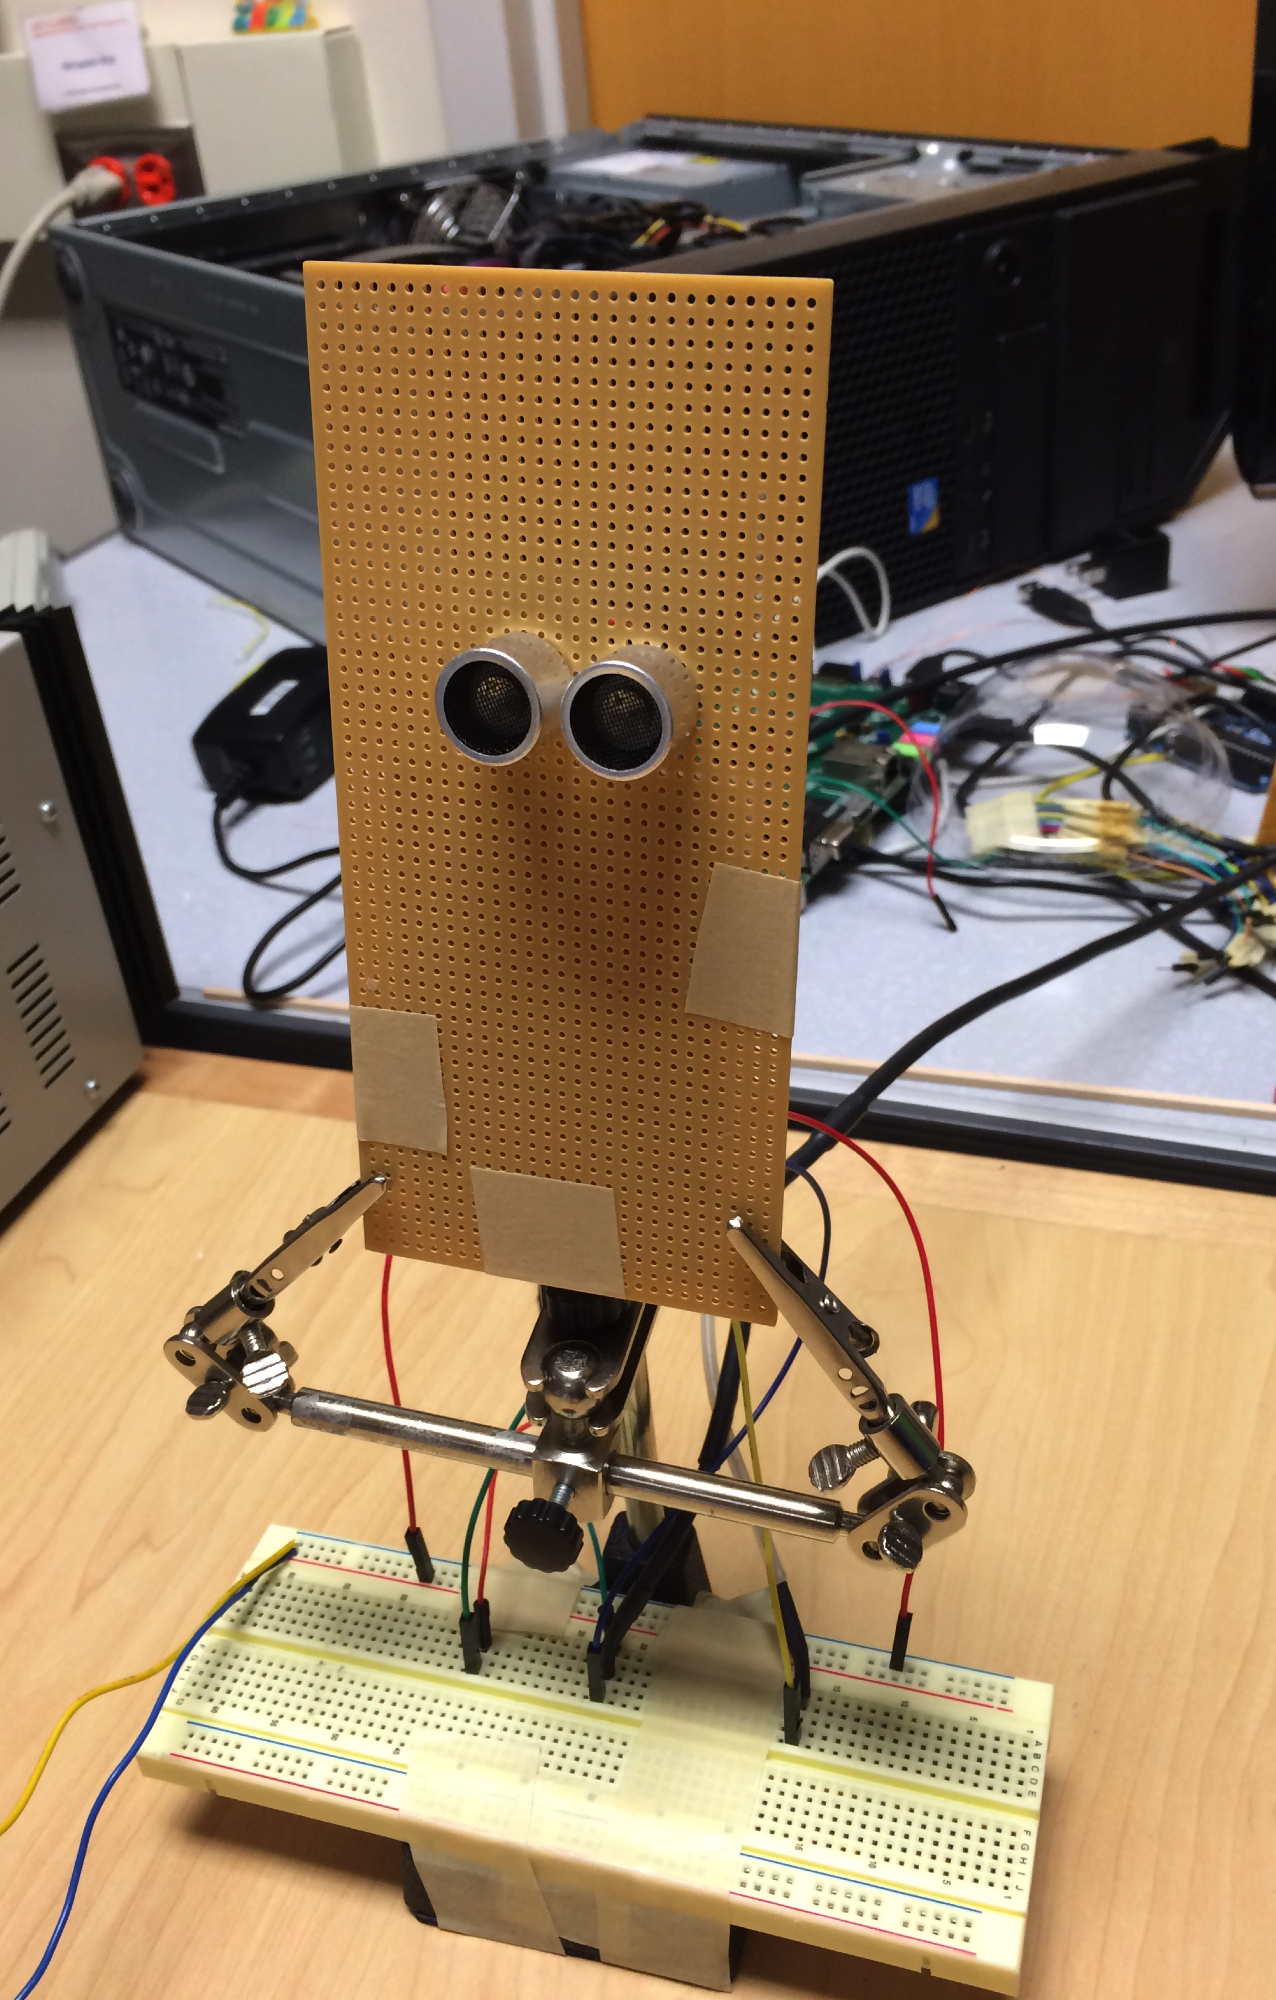
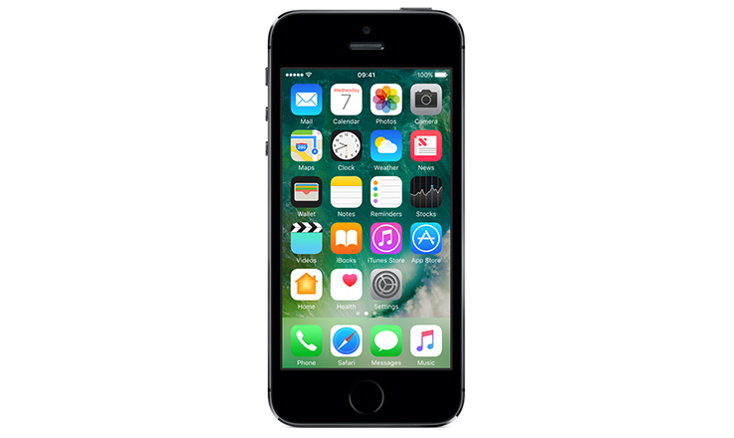
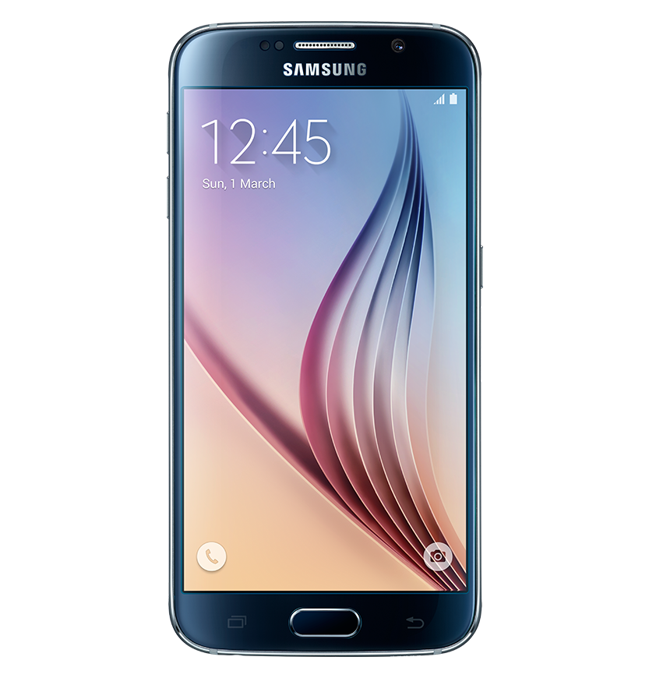
Hardware generalizability
40 kHz
50 kHz
Hearing Aid
Camera
iPhone
Android
phone
Smartwatch
Laptop
Notes:
First we verified if the basic concept works for common microphone enabled devices…SO we played two simple tones from the speakers…and recorded the shifted frequency with devices like hearing aid …camera …smartphones etc.
This graph shows that the shifted frequency has similar SNR in all these devices…therefore can be used for BackDoor applications…without any modification.

Slide 46
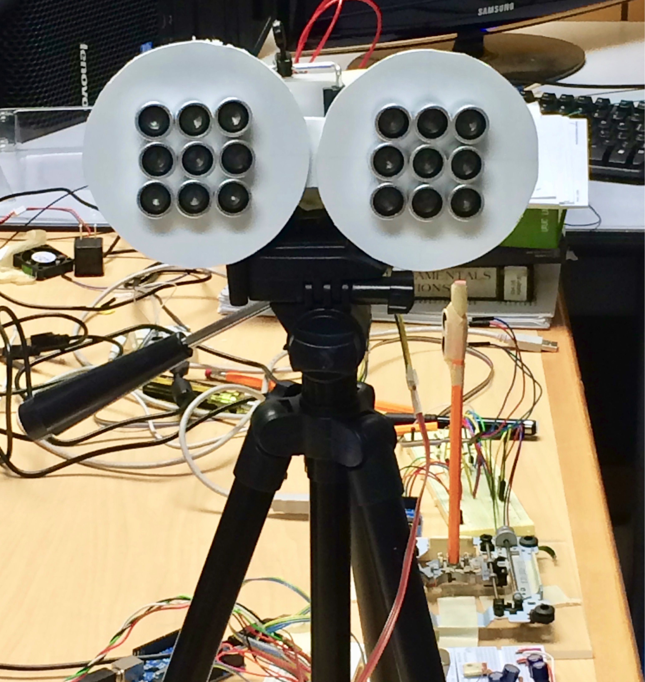
Implementation
Communication prototype
Jammer
prototype
Notes:
Now although we don’t need to change anything on the microphone devices., we need to build special speaker system for backdoor.
We implemented the BackDoor in two prototypes…the first one is the communication system that emulates acoustic beacon.
The other one is a jammer prototype with an array of speakers.

Slide 47
Communication performance
FM data packets
4kbps
up to 1 meter
More power can increase the distance
Notes:
we…evaluated the performance of our communication prototype by sending datapacket to a smartphone…the result shows that it can achieve 4kbps of datarate upto a distance of 1 meter. Of course we can vary the signal power to increase or decrease the distance of coverage

Slide 48
Jamming performance
Spy
microphone
BackDoor jammer
Notes:
Finally we tested the performance of the jammer. Here we assume that there is a spy microphone somewhere in the room and a backdoor jammer in the center…

Slide 49
Jamming performance
Spy
microphone
BackDoor jammer
Notes:
We are interested in the maximum jamming radius of our prototype…of course this does not fully define the experiment…the result will depend on the location of the sound source the spy is trying to record.

Slide 50
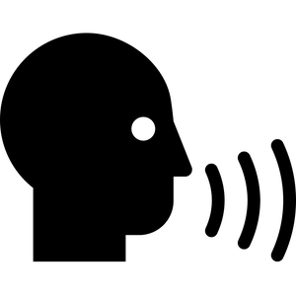
Jamming performance
Spy
microphone
BackDoor jammer
Notes:
Obviously if the sound source is far away fro the spy microphone…then it is easier to jam..

Slide 51
Jamming performance
Spy
microphone
BackDoor jammer
Notes:
To test the worst case performance of the jammer we assumed the source is right next to the spy microphone…

Slide 52
Jamming performance
Spy
microphone
BackDoor jammer
Notes:
And repeated this experiment for various distances.

Slide 53
Jamming performance
2000 spoken words
Jammed recording
BackDoor jammer
Notes:
In each experiment we recorded 2000 spoken words with the spy microphone and collected the jammed recording.

Slide 54


Jamming performance
2000 spoken words
Jammed recording
BackDoor jammer
Human
listener
Speech recognition
Notes:
Then we played it to both human users and automatic speech recognition software to decode the words…

Slide 55
Jamming performance
2000 spoken words
Jammed recording
BackDoor jammer
% of legible words
Human
listener
Speech recognition
Notes:
The percentage of the correctly decoded word is the metric for the jammer performance…

Slide 56
Jamming performance
100
Human users
Automatic speech recognition
80
60
Legibility of words (%)
40
20
0
1.0m
1.5m
2.0m
2.5m
3.0m
3.5m
4.0m
4.5m
5.0m
No Jam
Jamming distance
Notes:
This graph plots this percentage for various distances…observe that the prototype can effectively jam up to 3 meters. If we attempt to achieve similar performance with audible sound..its loudness will be like..

Slide 57

Jamming performance
Notes:
Running a jackhammer in the room.

Slide 58
Takeaways
Specially designed inaudible sound can be recorded with unmodified microphone
1
It can make acoustic jammer possible and also can be a communication channel
2
It also uncovers threats like acoustic Denial-of-Service attacks
3
Notes:
To summarize..we have shown that ultrasonic frequencies can be designed to be recordable by microphone…enabling applications like acoustic jammer and beacons…also it uncovers a threat of acoustic denial of service attacks.

Slide 59
Thank You
SyNRG group website: http://synrg.csl.illinois.edu

Slide 61
Jamming performance
100
Human users
Automatic speech recognition
80
60
Legibility of words (%)
40
20
0
4.0m
Jamming distance
Notes:
For example at 4 meter from the jammer

